Slide 2
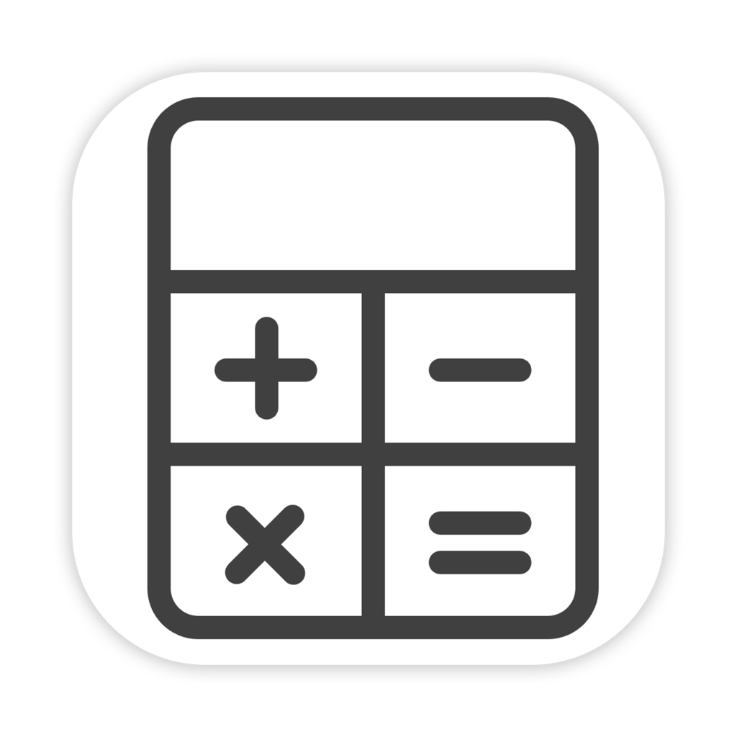

Slide 3
zero
0

